Slide 1
Data base
Management
System
“You can have data without information, but you cannot have information without data.”

Slide 2
Books
Database Management Systems, 3rd Edition - Raghu Ramakrishnan.
Introduction to Database Systems, Seventh Edition - C. J. Date.
SQL, PL/SQL: The Programming Language Of Oracle 4th Edition - Ivan Bayross.

Slide 3
Memory
WHY?
Do you remember everything of your life? We don't have to go that far: Every single time we go out for the shopping :) Do we remember the items we purchased in last Year? Think: Its about quantity of information? Or quality of information? Or Both? Why it is essential to memorize everything?
HUMAN

Slide 4
Storage
WHY?
Maintains. Students notes. Patients information. NADRA Passport Tax What would be the best option to mark attendance, if instructor don't have any automated attendance sheet.

Slide 5
Access
How?
Every single month we received Utility Bill. POS (Point of sale) printed trasactions.
Employee get the printed salary slip.
Online booking orders and track the logistics.
Students view their marks and attendance.
Reason to Store
Reports?

Slide 6


MECHANISM
Maintaining and Managing Data
Data Repository
Processing over Data.
Access and View.

Slide 7
Technical Perspective
Writing a program which
Takes input from user and print it.

Slide 8
Technical Perspective
Writing a program which
Takes input from user in numbers and print Sorted data.

Slide 9
Technical Perspective
Writing a program which
Takes input from user in numbers and print Sorted data with
(Optimal Solution)

Slide 10
Technical Perspective
Writing a program which
Takes input from user in numbers and print Sorted data with
(Optimal Solution) and stored to recall again.

Slide 11
Technical Perspective
Why Complexity?

Slide 12
File System Vs DBMS
A company has a large collection (say, 500 GB) of data on employees, departments, products, sales, and so on. This data is accessed concurrently by several employees. Questions about the data must be answered quickly, changes made to the data by different users must be applied consistently, and access to certain parts of the data (e.g., salaries) must be restricted. We can try to manage the data by storing it in operating system files. This approach has many drawbacks, including the following: 1- We probably do not have 500 GB of main memory to hold all the data. We must therefore store data in a storage device such as a disk or tape and bring relevant parts into main memory for processing as needed. 2- Even if we have 500 GB of main memory, on computer systems with 32-bit addressing, we cannot refer directly to more than about 4 GB of data. We have to program some method of identifying all data items. 3- We have to write special programs to answer each question a user may want to ask about the data. These programs are likely to be complex because of the large volume of data to be searched. 4- We must protect the data from inconsistent changes made by different users accessing the data concurrently. If applications must address the details of such concurrent access, this adds greatly to their complexity. 5- We must ensure that data is restored to a consistent state if the system crashes while changes are being made. 6- Operating systems provide only a password mechanism for security. This is not sufficiently flexible to enforce security policies in which different users have permission to access different subsets of the data.

Slide 13
Advantages of DBMS
Data Independence: Application programs should not, ideally, be exposed to details of data representation and storage, The DBMS provides an abstract view of the data that hides such details. Efficient Data Access: A DBMS utilizes a variety of sophisticated techniques to store and retrieve data efficiently. This feature is especially important if the data is stored on external storage devices. Data Integrity and Security: If data is always accessed through the DBMS, the DBMS can enforce integrity constraints. For example, before inserting salary information for an employee, the DBMS can check that the department budget is not exceeded. Also, it can enforce access controls that govern what data is visible to different classes of users. Data Administration: When several users share the data, centralizing the administration of data can offer significant improvements. Experienced professionals who understand the nature of the data being managed, and how different groups of users use it, can be responsible for organizing the data representation to minimize redundancy and for fine-tuning the storage of the data to make retrieval efficient.

Slide 14
Advantages of DBMS
Concurrent Access and Crash Recovery: A DBMS schedules concurrent accesses to the data in such a manner that users can think of the data as being accessed by only one user at a time. Further, the DBMS protects users from the effects of system failures. Reduced Application Development Time: Clearly, the DBMS supports important functions that are common to many applications accessing data in the DBMS. This, in conjunction with the high-level interface to the data, facilitates quick application development. DBMS applications are also likely to be more robust than similar stand-alone applications because many important tasks are handled by the DBMS (and do not have to be debugged and tested in the application).

Slide 15
Relational model
A description of data in terms of a data model is called a schema. In the relational model, the schema for a relation specifies its name, the name of each field (or attribute or column), and the type of each field.
As an example, student information in a university database may be stored in a relation with the following schema:
Students(sid: string, name: string, login: string, age: integer, gpa: real)

Slide 16
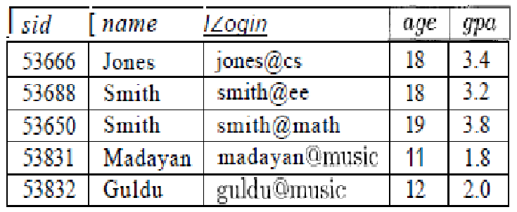
Relational model
The preceding schema says that each record in the Students relation has five fields, with field names and types as indicated.
Is this a complete information with respect to student ?

Slide 17
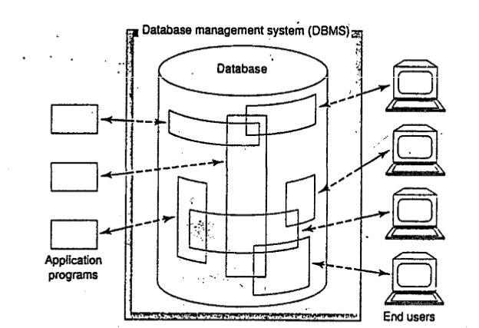
Database systems (simplified)
Notes:
Discussed in class with the example (User group) of Single server having multiple database and the communication of end users with multiple servers.
Had discussed the possibilities of connecting two databases on different servers.
Discussed the importance of Application programs in data base systems.
What sort of data would be reflect to end users?

Slide 18
Data model
A data model is a collection of high-level data description constructs that hide many low-level storage details. / A set of concepts to describe the structure of a database, and certain constraints that the database should obey.
Relational Model:
Network Model:
Hierarchical Data Model:
Object-oriented Data Model(s):
Object-Relational Models:
Notes:
Why we are constructing the data models?
Operations and constraints.
Elaborated in class with examples…
Hint: Example of Trees structure
Example of Class and object with respect to the OODM

Slide 19
Categories of data models
Conceptual (high-level, semantic) data models: Provide concepts that are close to the way many users perceive data. (Also called entity-based or object-based data models.)
Physical (low-level, internal) data models: Provide concepts that describe details of how data is stored in the computer.
Implementation (representational) data models: Provide concepts that fall between the above two, balancing user views with some computer storage details.
Notes:
Make sure to retain the difference between 3 layers ANSI/SPARK and categories of data models

Slide 20
Schemas versus Instances
Database Schema: The description of a database. Includes descriptions of the database structure and the constraints that should hold on the database.
Schema Diagram: A diagrammatic display of (some aspects of) a database schema.
Database Instance: The actual data stored in a database at a particular moment in time. Also called database state (or occurrence).

Slide 21
Data model
A semantic data model is a more abstract, high-level data model that makes it easier for a user to come up with a good initial description of the data in an enterprise.
semantic data model called the entity-relationship (ER) model allows us to pictorially denote entities and the relationships among them.
Relational Model
The central data description construct in this model is a relation, which can be thought of as a set of records.
Notes:
Above models belongs to the entity structure.

Slide 22
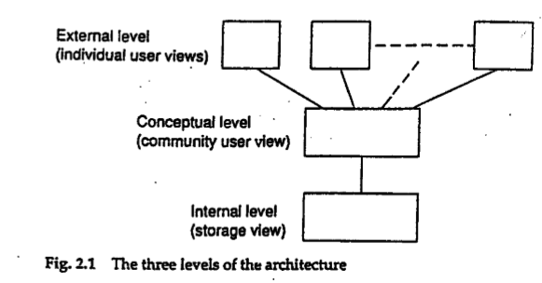
ANSI / SPARC Architecture
• Proposed a framework for DBMS in 1975
• American National Standards Institute
• Standards Planning Requirements Committee
Three tier architecture
• Internal level - for systems designers
• Conceptual level - for database designers
• External level - for database users
Notes:
Don’t confuse your self three tier of network architecture and Data base ANSI/SPARK three tier architecture.

Slide 23
Conceptual Level
• Deals with the organization of the entire database content
• Abstractions are used to remove unnecessary details of the internal level
• Used by DBAs and application programmers
• Conceptual Schema:
• For example:
CREATE TABLE Employee ( Name VARCHAR(25), Salary REAL, Department VARCHAR(10) )

Slide 24
Conceptual Level
Students(?)
Faculty(?)
Courses(?)
Rooms(?)
Enrolled(?)
Teaches(?)
Meets-In(?)

Slide 25
Conceptual Level
Students(sid: string, name: string, login: string, age: integer, gpa: real)
Faculty(fid: string, fname: string, sal: real)
Courses(cid: string, cname: string, credits: integer)
Rooms(no: integer, address: string, capacity: integer)
Enrolled(sid: string, cid: string, grade: string)
Teaches(fid: string, cid: string)
Meets-In(cid: string, rno: integer, time: string)

Slide 26
External Level
• Provides a view of the database tailored to a user
• Parts of the data may be hidden
• Used by end users and application programmers
External Schema:
• For example:
Create View myView as { SELECT Name FROM Employee }
Notes:
Elaborate the difference of user view and database view, how we are able to use the data base view and why it is usefull.

Slide 27
Internal Level
Deals with physical storage of data
• Structure of records on disk - ﬁles, pages, blocks
• Indexes and ordering of records
• Used by database system programmers
• Internal Schema:
For example:
RECORD EMP
LENGTH=44
HEADER: BYTE(5) OFFSET=0
NAME: BYTE(25) OFFSET=5
SALARY: FULLWORD OFFSET=30
DEPT: BYTE(10) OFFSET=34

Slide 28
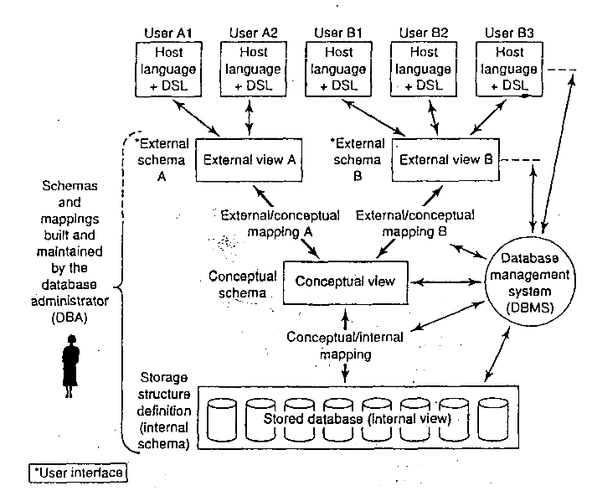
Detailed Architecture

Slide 29
Different States of SQL Server Database
A SQL Server Database is can only be in one specific state at a given time. Different States of SQL Server Database are:-
ONLINE:- When a database is in ONLINE state the database is available for access. The primary file group is online even though the undo phase of recovery may not have been completed. OFFLINE:- When a database is in OFFLINE state then the database is not accessible for user connections. One can set the database to this state if you don’t want users to connect to the database. For example you have migrated the database to a new server and don’t want users to accidently connect to the Old SQL Server Database. RESTORING:- When a database is in RESTORING state then it means one or more files of the primary file group is been restored or one or more secondary files are being restored offline. RECOVERING:- When a database is in RECOVERING state it means its in the process of recovery and it will become automatically ONLINE for user connectivity. In case of a failure the database will become SUSPECT and become unable for use until a database intervene and fixes the issues. RECOVERY PENDING: - When a database is in RECOVERY PENDING state it means SQL Server has encountered a resource related error during recovery. The database might be missing files. DBAs intervention is required in such a case.
SUSPECT: - When a database is in SUSPECT state it means the database is unavailable for user connection. Database may be damaged or at least the primary file group is suspect. DBAs intervention is required in such a case.

Slide 30
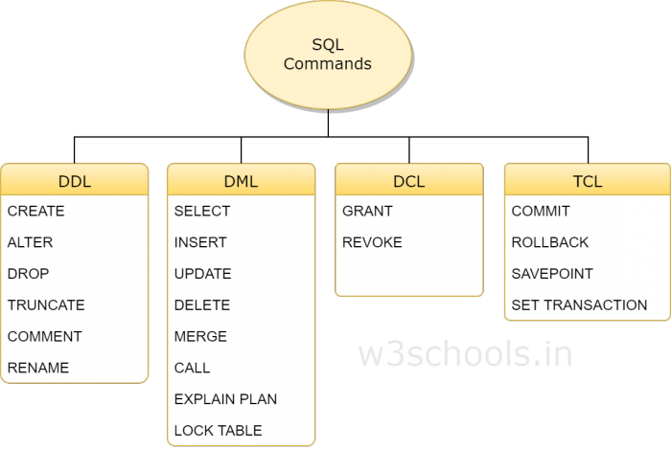
SQL (Types)

